Slide 1

Monitoring Series :
LOG MONITORING
Infra Class : 23 January 2020
Heronimus Tresy <heronimus.tresy@gdn-commerce.com>

Slide 2
what we already Monitor .. ?
In previous section ...

Slide 3

ever heard Log Monitoring .. ?
Log File
Log Monitoring
Purposes
Log Monitoring Tools

Slide 4
Log File
Log file is a file that records either events that occur in an operating system or other software runs.
>> /var/log/messages
>> /var/log/httpd/access_log
>> /var/log/nginx/error.log
>> ….. etc
Notes:
system log
application log (java, web server)

Slide 5
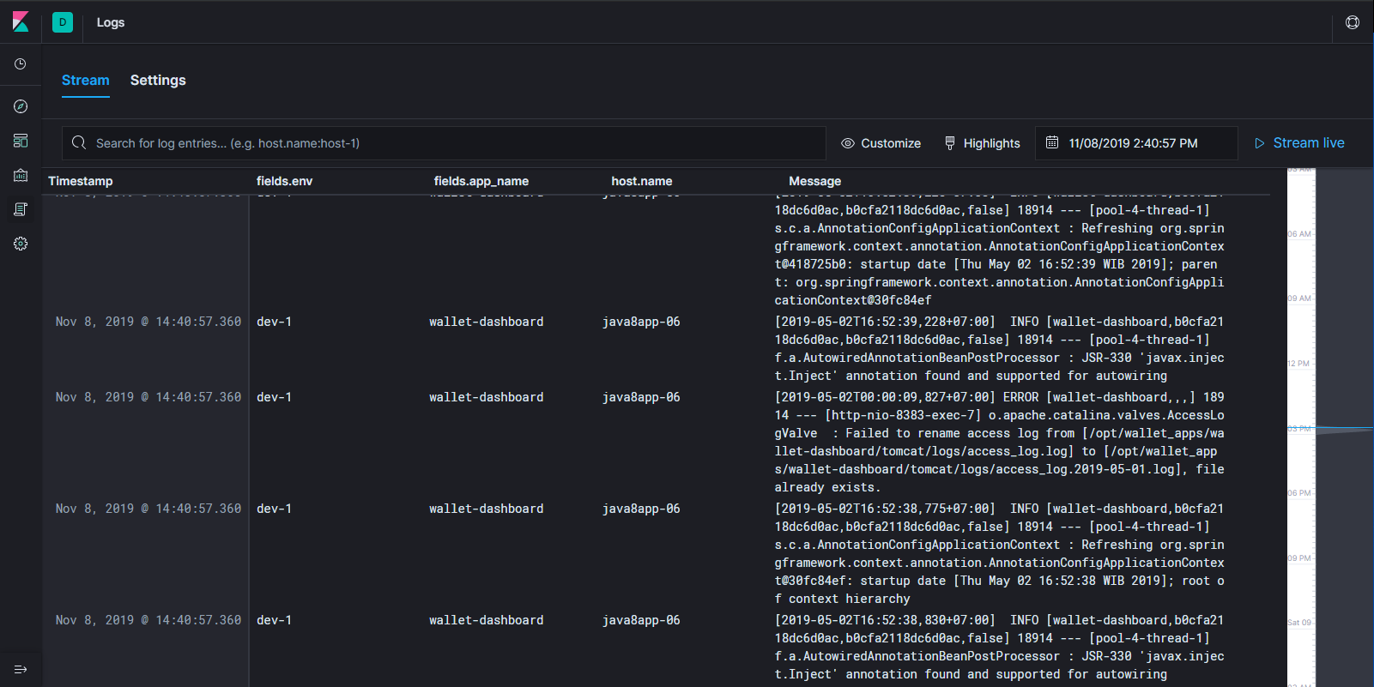
Log Monitoring / Log Management
Collective processes and policies used to administer and facilitate the generation, transmission, analysis, storage, archiving and ultimate disposal of the large volumes of log data created within an information system.

Slide 6

Purposes
Problem Detection
Identify Event
Archive Transaction Log
Data Analysis
Notes:
troubleshoot / detect problem
identify security event
bank cases (log save)

Slide 7
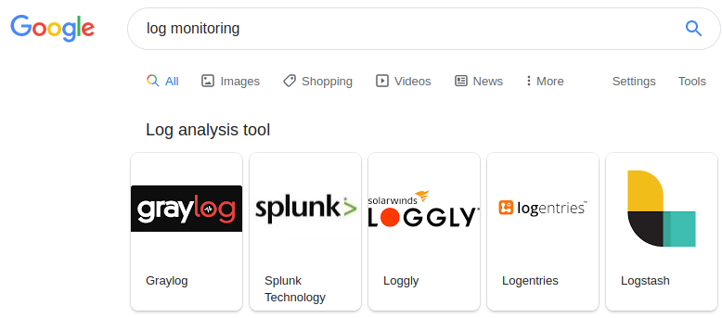

Log Monitoring
Tools
Notes:
Show example

Slide 8
Elasticsearch stack
for Log Monitoring System.

Slide 9
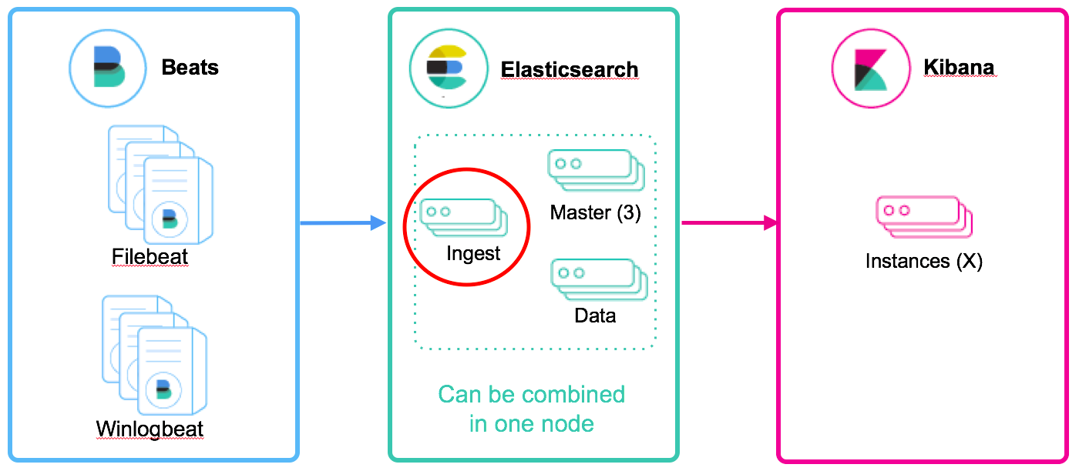
Elasticstack (EFK/ELK/Exx) Architecture
https://www.elastic.co/blog/new-way-to-ingest-part-2
Notes:
Load Balance & HA Architecture

Slide 10
Demo !
Notes:
Many configuration required, will be guided together.
Will share the material later
WIll use large downloaded material

Slide 11
Other Useful Link
https://www.elastic.co/guide/en/elasticsearch/
https://openapm.io/
Connect to hotel SSID,
Open this on your web browser !
http://192.168.0.15:7777
or
http://patrickstar.local:7777

